Slide 1
Health Studies Unit 1 & 2
Year 11 ATAR
Direct message: Miss Katie Hair
Email: khair@kennedy.wa.edu.au

Slide 2
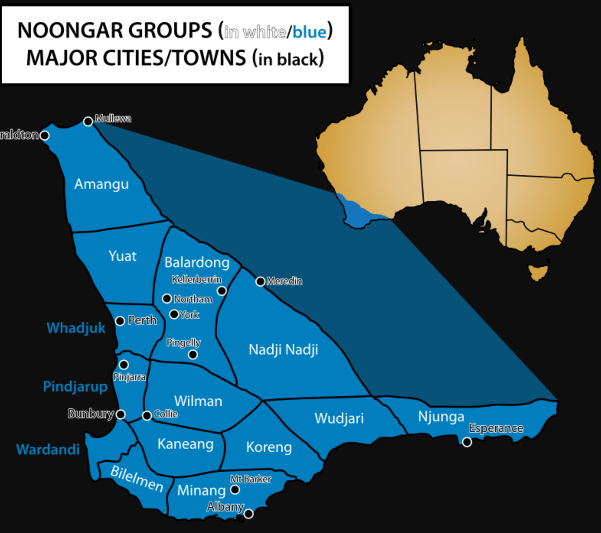
Acknowledgment of Country
“I respectfully acknowledge the past and present traditional custodians of this land on which we are meeting, the Whadjuk people of the Noongar Nation. It is a privilege to be standing on country. I also acknowledge the contributions of Aboriginal Australians and non-Aboriginal Australians to the education of all children and people in this country we all live in and share together – Australia.”

Slide 3

Who are you?
Why are you doing Health Studies?
What do you think Health Studies is?
What can health studies lead to?
Any medical field
Social work
Life!
This Photo by Unknown Author is licensed under CC BY-SA

Slide 4
Who am I?
Why am I teaching Health Studies?
This Photo by Unknown Author is licensed under CC BY-SA

Slide 5
What will this course look like?
5 periods per week
Interactive lectures
Discussions
Practise questions/applications
Revision lessons
Tutoring is provided: Use it!

Slide 6
What do I expect of you?
Attention
Engagement
Organisation
Behaviour
Ask Questions
Stay open minded and respectful
Take responsibility for your own learning
Work hard! (it is an ATAR course, after all!)

Slide 7
What you’ll need:
Textbook (Emily Lockhart)
Incomplete lecture slides to fill in as we go
Complete lecture slides presented in class
Glossary
A file/something to collate loose sheets etc.
A system for your study notes (my recommendation is a blank lined notebook of some kind, but some people prefer index cards or similar!)
Course outline and assessment outline

Slide 8
Let’s get to know each other!
Rock paper scissors
Paper form
Two truths and a lie

Slide 9
Nine Dot Challenge
On a piece of paper, draw nine dots in a 3 x 3 grid.
The challenge is to connect the nine dots with only 4 straight lines, without lifting the pencil from the paper.
SOLUTION:
Starting in any corner, draw a diagonal line to the opposite corner. Second, make a horizontal line from that dot to the dot at the other side of your square, but continue onward the length of a fourth invisible dot. Third, draw diagonally, through two middle dots, again continuing your line to the next imaginary dot. Finally, draw a vertical line through the two remaining dots.

Slide 10
What is Health Studies?
The exploration of health as a DYNAMIC quality of life.
Social, environmental, biological and economic factors that influence individual and community health.
Explores barriers that prevent people groups from experiencing better health.
Application of inquiry skills to analyse health issues.
Discussion of current affairs. Start watching The Project, abc, sbs and all the documentaries

Slide 11
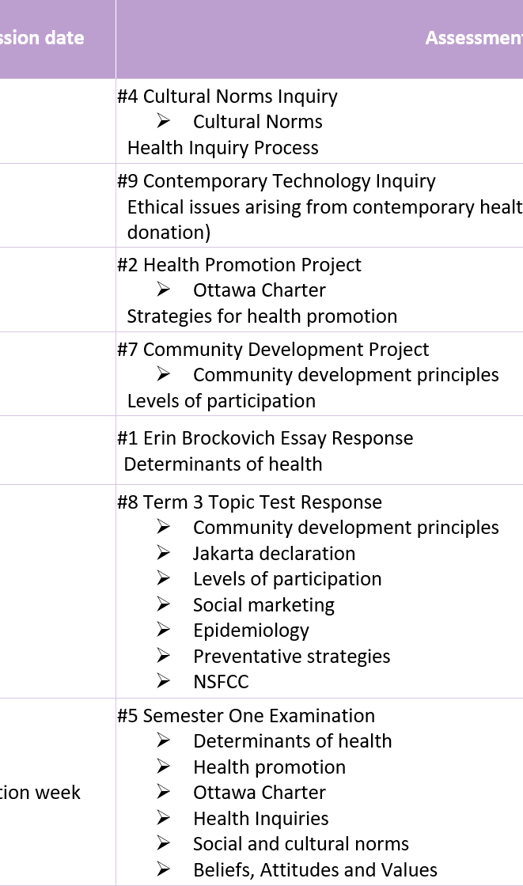
Assessments
There are 8 plus exams
Feedback is the key – Use it
Referencing – APA must be included, or it won't be accepted
Have fun with them!! Choose topics that interest you!

Slide 12
Where does our information come from?
World Health Organisation
Australian Institute of Health and Welfare
Google Scholar
Ebsco (Research Database from R&SC)
RASC site – Password Baptist
Database Ebsoc – Password is Baptist-20

Slide 13
What is Health?

Slide 14
Definition of Health
What do you think the term “Health” means?
Health is a state of complete physical, mental and social well-being and not merely the absence of disease or infirmity’ (WHO 1946).
What does this actually mean?
According to this definition, are you experiencing good health? What about people who live in worse conditions than us?

Slide 15
Determinants of health:
Factors that help to explain and predict trends in health and explain why some populations have better health than others.
Play a major role in the prevention of disease, illness and injury.
Determinants can be risk factors (e.g. smoking) and other determinants can be protective factors (e.g. healthy food intake)
Behavioural factors can change.
Biological factors (age, sex and genetics) cannot be changed.

Slide 16
Determinants of Health
Social
Environmental
Socio-economic
Biological
Social gradient
Unemployment
Early life
Social exclusion
Work
Stress
Addiction
Food
Transport
Social support
culture
Extreme weather
Bushfires
Storms and flooding
Food and water quality
Vector agents
UV radiation
Air quality
The built environment
Education
Employment
Housing
Income
Access to services
Neighborhood
Family
Migration status
Food security
Body weight
Birth weight

Slide 17
Social Determinants of Health
SYLLABUS:
Social Determinants of Health:
Social gradient
Stress
Early life
Social exclusion
Work
Unemploymnet
Social support
Addiction
Food
Transport
Culture
Impact on personal and community health status of social, environmental, socioeconomic and biomedical determinants of health

Slide 18
Learning Outcomes
Outline
Outline each determinant
Relate
Relate determinants to Health Status: life expectancy, quality of life and morbidity
Example
Be able to describe (glossary of terms) in detail each determinant
Provide a detailed example on how it can positively and negatively affect health status of and individual and a community

Slide 19

Social Gradient
Social class system-upper, middle, lower
Characterised by income, housing, education and/or wealth
Closely linked to life expectancy (lower on the social gradient tends to lead to a shorter life expectancy)
More information
This Photo by Unknown Author is licensed under CC BY-SA

Slide 20
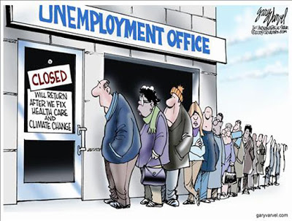
Unemployment
More than just money
Psychological, financial and social consequences
Working is better for health than not working…WHY?
Unemployment tends to lead to increased stress, anxiety and depression
http://www.euro.who.int/__data/assets/pdf_file/0005/98438/e81384.pdf
This Photo by Unknown Author is licensed under CC BY-SA-NC

Slide 21

Early Life
First years of life impact heavily on an individual later in life. (key developmental years)
Mothers health during pregnancy and birth has an impact
Poor fetal development (ie. Malnutrition, stress or drug use by the mother)
http://www.euro.who.int/__data/assets/pdf_file/0005/98438/e81384.pdf
This Photo by Unknown Author is licensed under CC BY-SA-NC

Slide 22
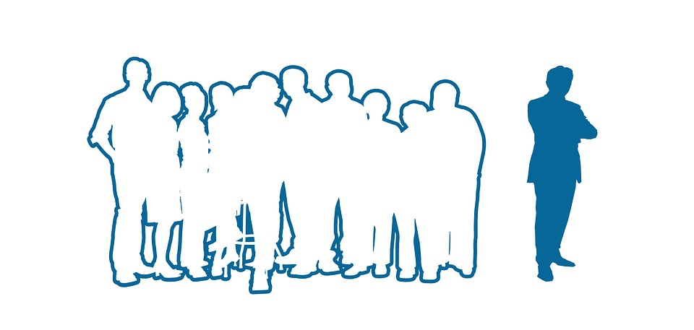
Social Exclusion
Can be due to a range of reasons ie. Poverty, discrimination, disability, location
Withdrawal from community life can lead to lack of support systems and emotional stability-therefore leading to poorer health.
http://www.euro.who.int/__data/assets/pdf_file/0005/98438/e81384.pdf

Slide 23

Work
Working (paid or voluntary) is good for health
Highly rewarding workplaces lead to improved self esteem, self worth, motivation and satisfaction
BUT Dangerous or hazardous workplaces can be detrimental to health
Highly stressful workplaces can be detrimental to health.
Demeaning workplaces can be detrimental to an individuals physical, mental and emotional health
http://www.euro.who.int/__data/assets/pdf_file/0005/98438/e81384.pdf
This Photo by Unknown Author is licensed under CC BY-SA

Slide 24

Addiction
Addiction to unhealthy substances can be highly detrimental to an individuals physical, mental, emotional, social and financial health
The case of the chicken or the egg…which came first?
Addiction is a vicious cycle (see page 11 Textbook for the Addiction Cycle Diagram)
http://www.euro.who.int/__data/assets/pdf_file/0005/98438/e81384.pdf
Stressor or unhappiness
Drug/Alcohol use
High or feeling better
Can’t afford drug
This Photo by Unknown Author is licensed under CC BY-SA-NC

Slide 25

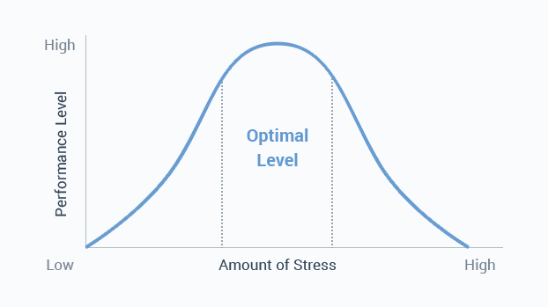
Stress
Stress itself is not bad, OVERSTRESS and UNDERSTRESS can be detrimental to health
Leads to psychological and physical issues (ie. Lowered immune system, anxiety, headaches, tiredness etc)
Can be caused by a range of factors
Fight or Flight response
Stress/Productivity relationship
This Photo by Unknown Author is licensed under CC BY-NC-ND

Slide 26
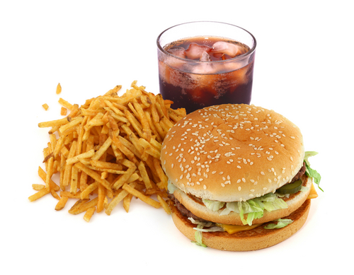
Food
Very strong correlation between nutrition and physical health.
Highly nutritious, balanced diet will lead to better health
Individuals who live in developing countries are less fortunate in that they are more limited in their access to nutritious food.
Quantity vs quality
Links to income
This Photo by Unknown Author is licensed under CC BY-SA

Slide 27
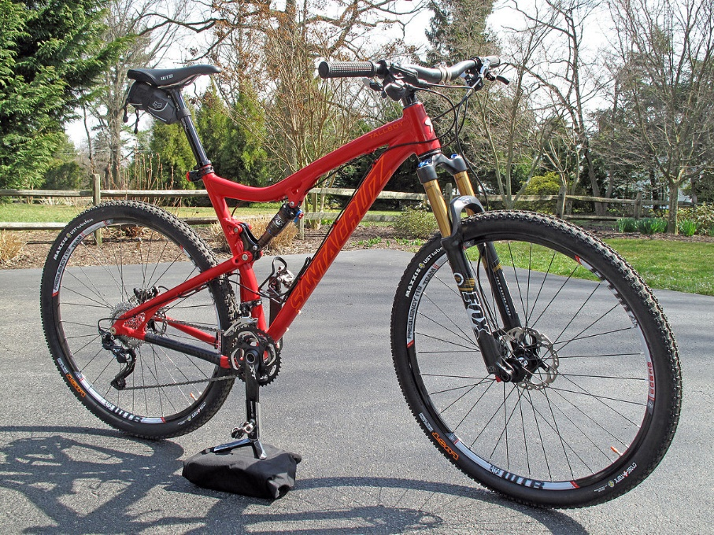
Transport
Exercise as a mode of transport is better for individual health and environmental health
Private vehicles vs public transport
Transport provides increased accessibility to medical services
This Photo by Unknown Author is licensed under CC BY-SA

Slide 28

Social Support
Individuals with positive, rewarding, close friendships tend to have better health that those who are isolated or have unhealthy relationships
Communities with lower levels of cohesion suffer from more crime, violence and lack of social respect-therefore tending to produce individuals who have poorer health.
This Photo by Unknown Author is licensed under CC BY-SA-NC

Slide 29

Culture
Cultural expectations can influence an individuals decisions regarding things like food choices, help seeking, rituals and traditions
Different cultures may have healing rituals or faith rituals
This Photo by Unknown Author is licensed under CC BY-SA-NC

Slide 30

SUE WAS Forced To
Sing Songs Constantly

Slide 31

Case study
Health Studies Page 9
Then quiz!

Slide 32
Sources
Lockhart, E. (2010). Health Studies Stage 2A-b. Madeley: Print Publishing.
Image from:
http://drawingchange.com/gathering-wisdom-visuals-for-a-healthy-future/

Slide 33
Environmental Determinants of Health
SYLLABUS:
Environmental Determinants of Health:
Features of the natural and built environment
Geographical location
Impact on personal and community health status of social, environmental, socioeconomic and biomedical determinants of health

Slide 34
Learning Outcomes
Outline
Outline each determinant
Relate
Relate determinants to Health Status: life expectancy, mobidity rates and quality of life
Example
Be able to describe (glossary of terms) in detail each determinant
Provide a detailed example on how it can positively and negatively affect health status of and individual and a community

Slide 35
Environmental concerns
What are the biggest environmental concerns being discussed today?

Slide 36
Definition:
Environmental Factors:
“Factors occurring externally to the person (usually out of the control of the individual) but also including behaviours undertaken by an individual that place them at risk of health effects due to an avoidable environmental factor”
(Lockhart, 2010).

Slide 37
Discussion:
Topic for Discussion: Sunbaking
Chat with your partner and whether you think it would be classified as an environmental determinant using the above definition.
Other examples?

Slide 38
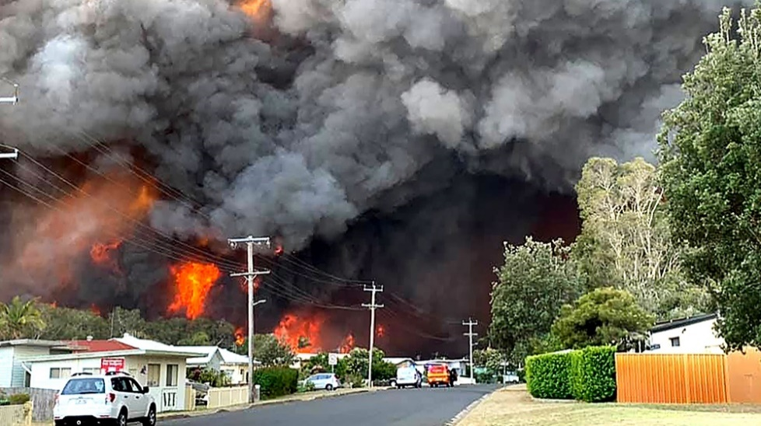
The Natural Environment in Australia
There are 5 commonly identified natural environmental factors that impact the health of Australians:
Extreme weather
http://blacksaturdayfires.com/ (most deaths)
https://www.youtube.com/watch?v=J__4V0ujlaU 12:10min
UV Rays
Air quality
Vector agents
Food and water quality

Slide 39
Extreme Weather
Extreme weather (click link for map) includes:
Cyclones
Bushfires https://www.smh.com.au/politics/federal/health-impacts-of-bushfires-won-t-be-known-for-years-experts-say-20200106-p53p87.html
Drought
Flooding
tsunamis
Includes not only physical harm but indirect harm (Mental, emotional, social)

Slide 40
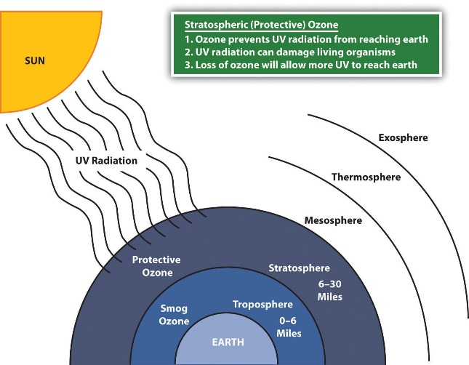
UV radiation
UV Radiation
High energy rays most commonly coming from the sun
Low exposure – Vit D deficiency (can lead to osteoporosis/rickets)
High exposure – Strong epidemiology link between high exposure and chronic skin/eye disease (cancers). In 2016, an estimated 13,280 new cases of melanoma will be diagnosed in Australia, and 1,770 people will die from this disease
This Photo by Unknown Author is licensed under CC BY-SA-NC

Slide 41
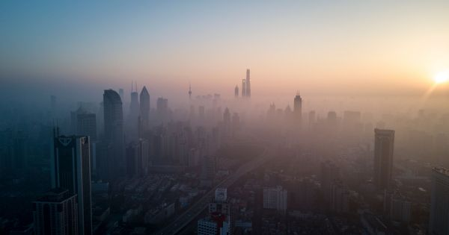
Air Quality
Pollution in atmosphere
Increase CO2 and other gases
Most common adverse health outcomes
Disorders of the respiratory system and cardiovascular system
This Photo by Unknown Author is licensed under CC BY-NC

Slide 42
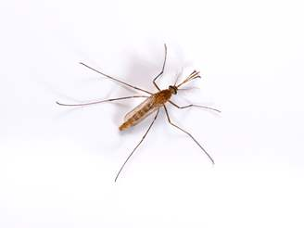
Vector Agents
Vector agents
Organism that transmits a disease, parasite or infection from one host to another (Most common vector agent disease in Australia are caused by mosquitos)
Ross River and Barmah Forest Virus
https://healthywa.wa.gov.au/Articles/N_R/Ross-River-virus-and-Barmah-Forest-virus
Malaria - https://www.mydr.com.au/travel-health/malaria-overview

Slide 43
Food and Water Quality
Virus and bacteria present in food or water can be dangerous to health
Salmonellosis – Bacteria causes fever, headaches, nausea, vomiting, abdominal pain, and diarrhoea. Occurs in eggs, poultry, and other meats, raw milk and chocolate.
In 2010 there were15.9 million foodborne cases reported annually in Australia (Kirk et al, 2014)
In 2014 it was estimated that due to foodborne illness, Australia and New Zealand combined had a financial loss of approximately $1.289 billion and $86 million respectively (McLinden et al, 2014)

Slide 44
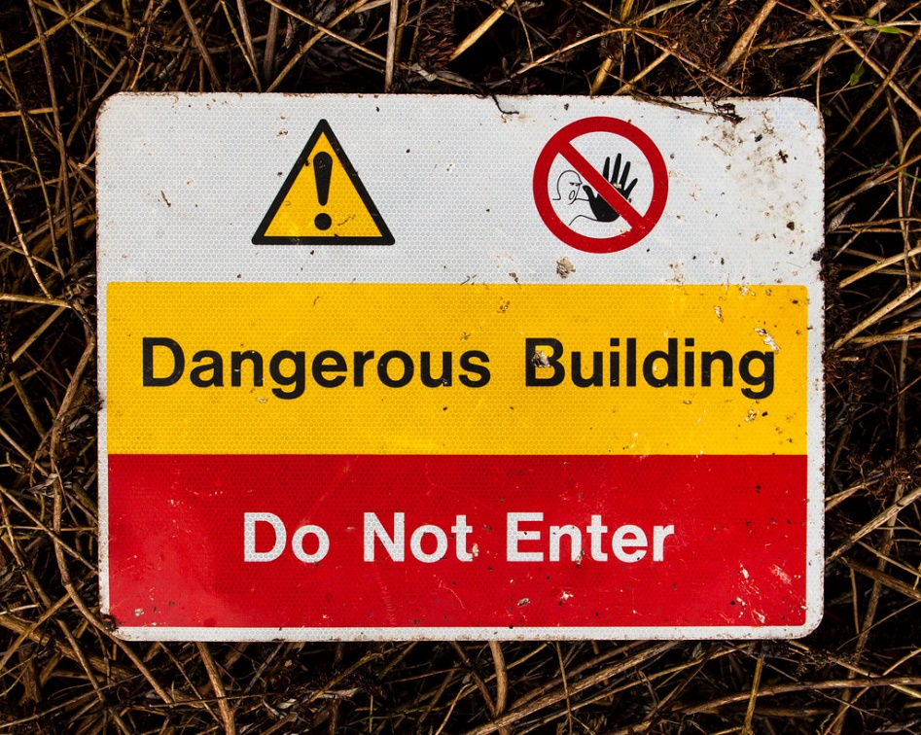
Features of the Man-Made Environment
How could the following man-made structures impact health?
Buildings?
Roads?
Other transport routes?
Waste disposal systems?
This Photo by Unknown Author is licensed under CC BY-SA-NC

Slide 45
TEXTBOOK pages 18-20
Indoor Air quality
Walkability
Transport
Green space
Environmental noise
Housing
Swan River https://thewest.com.au/news/wa/welshpool-chemical-spill-warning-issued-for-residents-and-workers-ng-b88353754z
Waste Products

Slide 46
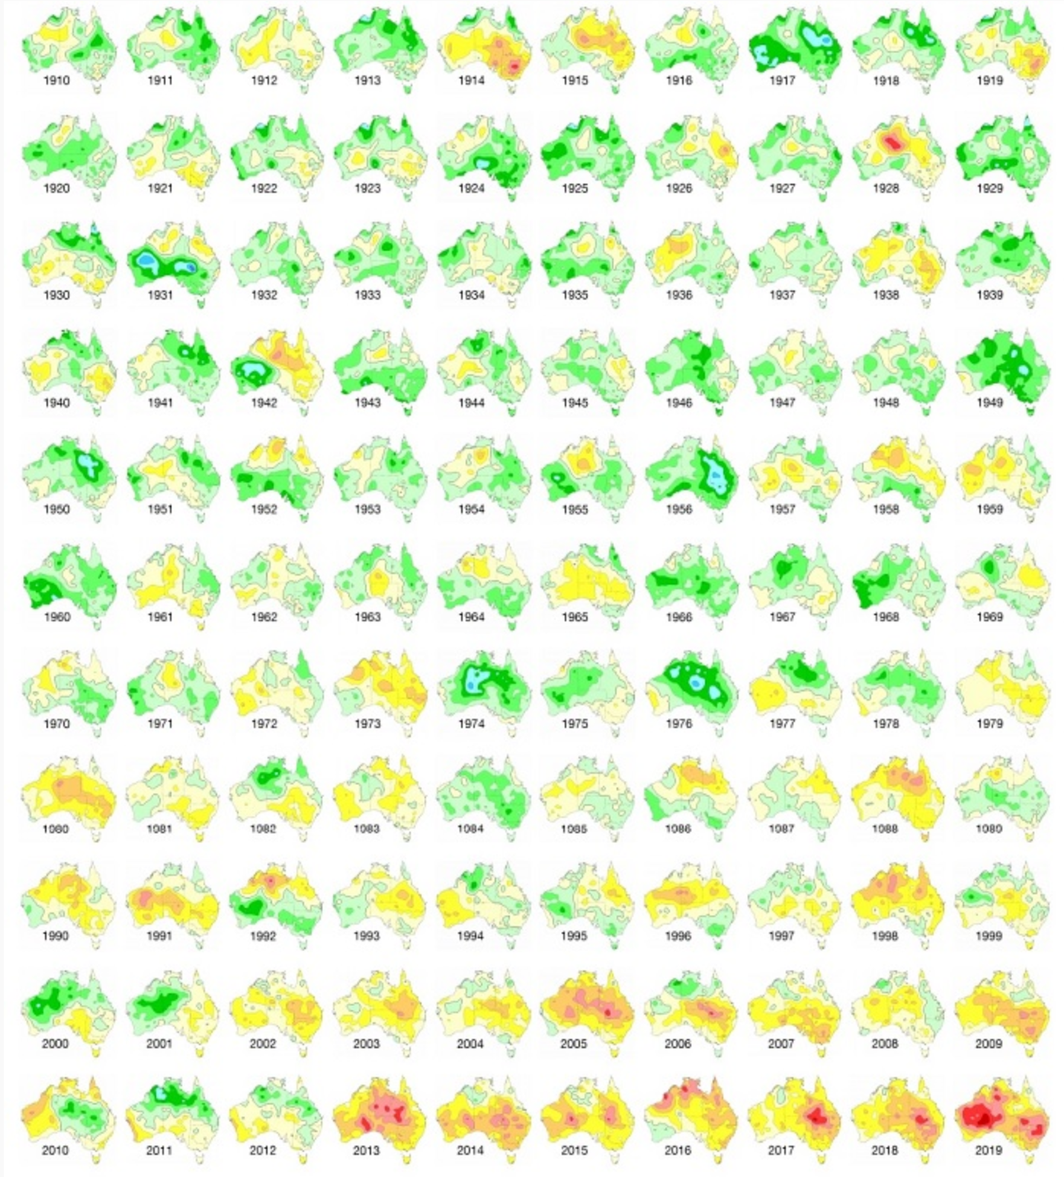
Climate Change in Australia
https://www.abc.net.au/news/2020-01-14/bureau-of-meteorology-chart-shows-how-temperatures-soared/11857404

Slide 47
Chinese Cancer Villages
https://www.youtube.com/watch?v=-rj9Wx_jg40
15 mins
Bring tissues

Slide 48
Sources
Lockhart, E. (2010). Health Studies Stage 2A-b. Madeley: Print Publishing.
Image from:
http://blog.tedmed.com/tag/social-determinants-of-health/
Kirk, M., Ford, L., Glass, K., & Hall, G. (2014). Foodborne Illness, Australia, Circa 2000 and Circa 2010. Emerging Infectious Diseases, 20(11), 1857-1864. https://dx.doi.org/10.3201/eid2011.131315.
McLinden, T., Sargeant, J. M., Thomas, M. K., Papadopoulos, A., & Fazil, A. (2014). Component costs of foodborne illness: a scoping review. BMC public health, 14, 509. doi:10.1186/1471-2458-14-509

Slide 49
Socioeconomic Determinants of Health
SYLLABUS:
Socioeconomic Determinants of Health:
Housing
Income
Family
Refugee/migration status
Access to services
Food security
Education
Employment
Impact on personal and community health status of social, environmental, socioeconomic and biomedical determinants of health

Slide 50
Learning Outcomes
Outline
Outline each determinant
Relate
Relate determinants to Health Status: life expectancy, morbidity rates, quality of life
Example
Be able to describe (glossary of terms) in detail each determinant
Provide a detailed example on how it can positively and negatively affect health status of and individual and a community

Slide 51

“Socioeconomic”
Wealth can be IN THE CONTROL of the individual
Ie. Education, employment, enterprise.
It can also be OUT OF THE CONTROL of the individual
Ie. Global markets and national economy.

Slide 52

Income
Links with Social Gradient
Moderate to high income individuals(and their children) will experience less illness, injury and disease.
Links to inequalities within populations relating to distribution of income – See Link
LOW income earning individuals tend to experience poorer health.
This Photo by Unknown Author is licensed under CC BY-NC

Slide 53

Employment
- employment type, rate and opportunity for promotion all influence income
- not always within the control of the individual (eg. unskilled or skills are not required in the community)

Slide 54

Education
High correlation to health status
Highly educated individuals live longer, have healthier children and less injury/illness/disease
Low education is associated with negative health behaviours-smoking, alcohol abuse, poor diet, lack of exercise.
Influences income
This Photo by Unknown Author is licensed under CC BY-NC-ND

Slide 55
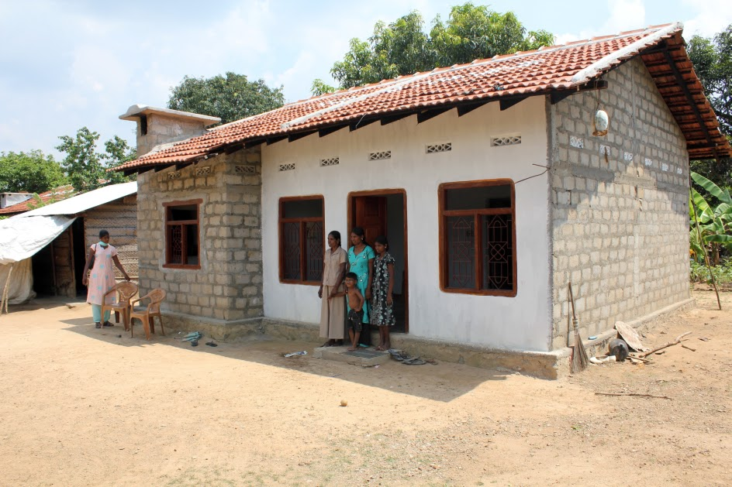
Housing
Quality of housing influences childhood health, growth, development and rate of illness/infection
Hygiene, safety, space, ventilation and locality.
Frequent movers, homelessness.
Locality: impacts levels of physical activity, rate of crime, proximity to services etc.
This Photo by Unknown Author is licensed under CC BY-NC-ND

Slide 56
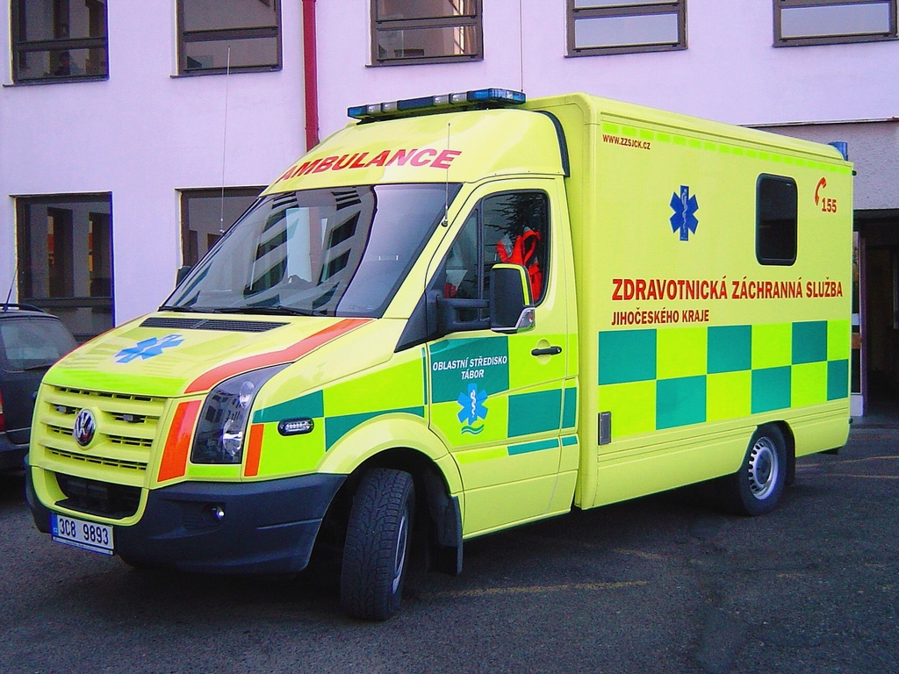
Access to Services
Treatment and prevention of illness/disease if accessibility is high
Geographical location, disability, education, availability
This Photo by Unknown Author is licensed under CC BY-SA

Slide 57
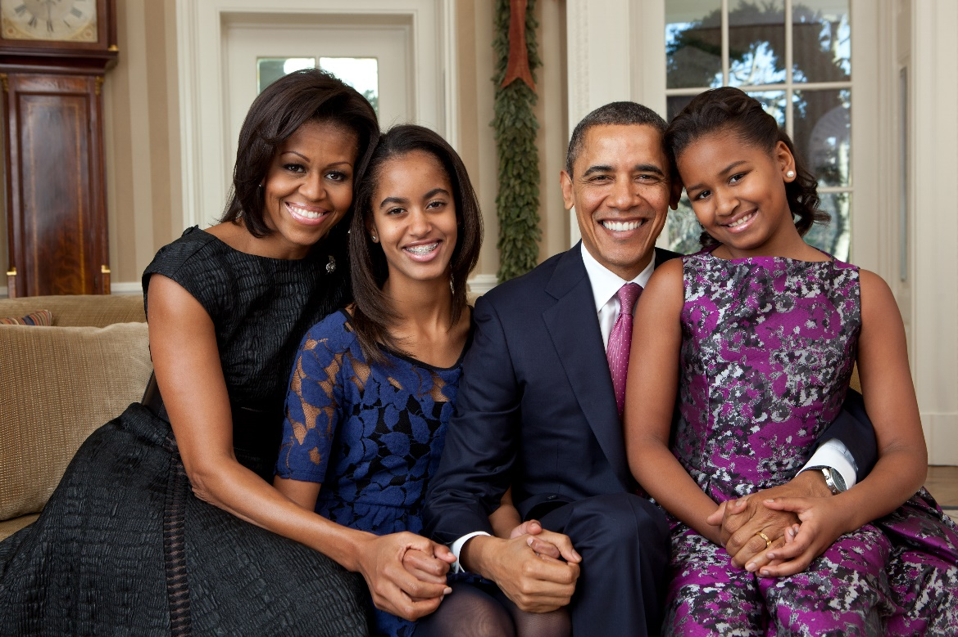
Family
- greater support from family leads to better health
- Family unit (separated parents/broken families)
This Photo by Unknown Author is licensed under CC BY-SA

Slide 58
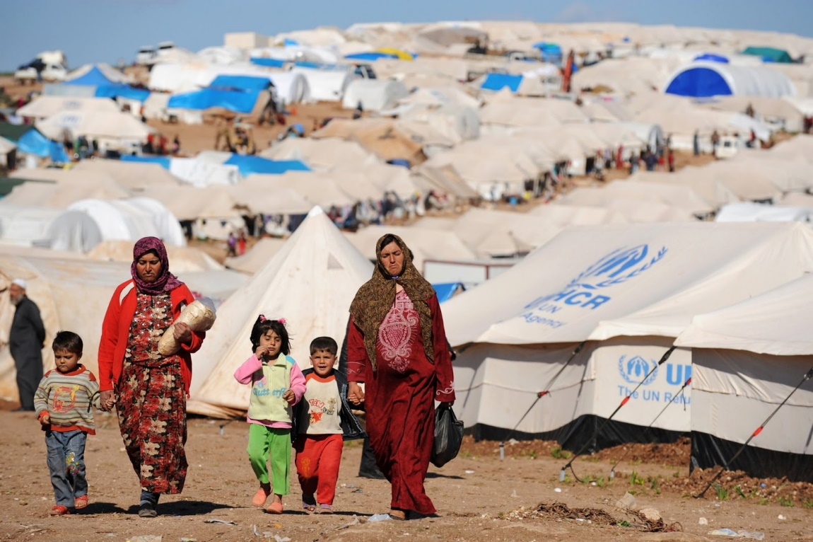
Refugee/migration status
The ability to work/earn a living
Being accepted into society
“dislocation of land” –stress
Trauma and mental health
Access to services
This Photo by Unknown Author is licensed under CC BY-SA

Slide 59
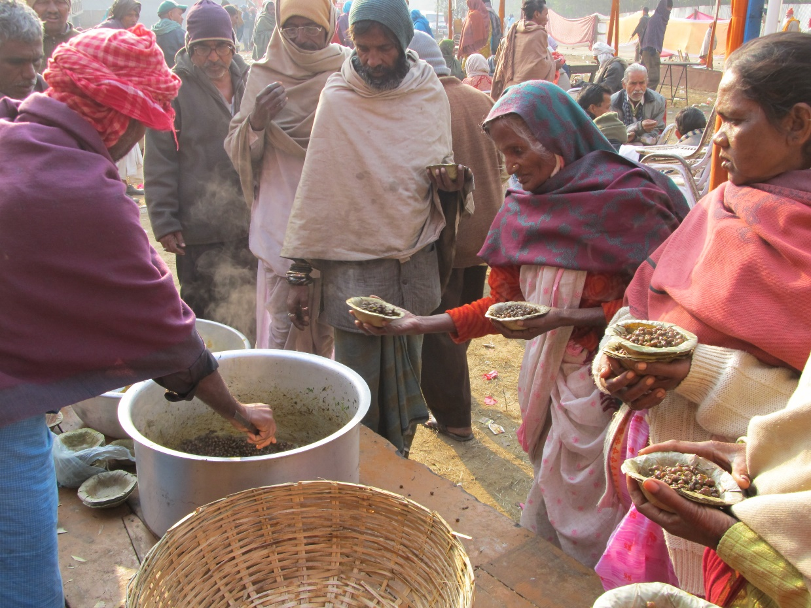
Food Security
Having reliable access to adequate food at all times. (quality and quantity)
Climate change
Product contamination (needles in fruit)
This Photo by Unknown Author is licensed under CC BY-SA

Slide 60
Biological Determinants of Health
SYLLABUS:
Biological Determinants of Health:
Birthweight
Bodyweight
Impact on personal and community health status of social, environmental, socioeconomic and biomedical determinants of health

Slide 61
Birth weight
UNDERWEIGHT (more detrimental) | OVERWEIGHT (less detrimental)
-increased risk of illness -can have delayed development or learning disabilities. -more likely if the mother smokes. Increased risk of type 2 diabetes, high blood pressure, renal disease, cardiovascular and pulmonary diseases. | -increased risk of obesity -increased risk of heart disease and diabetes

Slide 62
Premature and low birth weight - https://www.youtube.com/watch?v=8dDOnjxW3Sg
http://www.perthnow.com.au/news/western-australia/near6kg-baby-born-in-perth-on-australia-day-a-huge-bundle-of-joy-for-tassell-family/news-story/a433513db4d40a9f3f113748f1bffc07
http://www.babycentre.co.uk/a1033196/low-birth-weight-in-babies

Slide 63
Body weight
UNDERWEIGHT | OVERWEIGHT
-increased risk of illness (impaired immune function) -increased risk of osteoporosis | -increased risk of heart disease and diabetes, high blood pressure, lower limb stress injuries, shorter life expectancy,

Slide 64
A few interesting reads..
https://www.aihw.gov.au/reports/overweight-obesity/interactive-insight-into-overweight-and-obesity/contents/how-many-people-are-overweight-or-obese
https://www.worldobesitydata.org/map/overview-adults
http://www.huffingtonpost.com.au/2016/02/24/australia-obesity-statistics_n_9154422.html
http://www.healthline.com/health-blogs/diet-diva/dangers-underweight

Slide 65
Sources
Lockhart, E. (2010). Health Studies Stage 2A-b. Madeley: Print Publishing.
Images from:
http://www.buzzhubmedia.com/10-income-streams-for-your-business-janelle-belle/#prettyPhoto
http://www.sheknows.com/parenting/articles/968857/the-hottest-new-baby-boy-names-of-2012
http://www.healthline.com/health-blogs/diet-diva/dangers-underweight
https://www.nhlbi.nih.gov/health/health-topics/topics/obe/risks
http://www.perthnow.com.au/news/western-australia/near6kg-baby-born-in-perth-on-australia-day-a-huge-bundle-of-joy-for-tassell-family/news-story/a433513db4d40a9f3f113748f1bffc07
http://www.huffingtonpost.com.au/2016/02/24/australia-obesity-statistics_n_9154422.html
http://www.babycentre.co.uk/a1033196/low-birth-weight-in-babies

Slide 66
Class task:
Identify the 4 determinants of health that you feel that you understand the least.
Research those 4 and then share with a partner what your found about that determinant and its relation to health.

Slide 67
Writing in Health Studies

Slide 68
Writing in Health Studies
Monash writing style – Click here
Essays – Intro – body – conclusion – Click here
Referencing styles
https://libguides.murdoch.edu.au/APA/examples
https://library.nd.edu.au/referencing/apa
Let’s practice writing!
Choose a determinant of health that you understand well. Write a paragraph describing the determinant and explaining how it could influence an individual and community's health status. Use examples where possible.

Slide 69

ERIN BROKOVICH
Enjoy the movie
Look for determinants of health and examples
How is the health of the characters impacted
Take notes of the above
How is the health of the community?

Slide 70
Writing in Health Studies
Planning an essay
Identify key points
Examples
Basic structure
Mark allocation
Practice essay response task:
Identify and explain 2 connected socio-economic determinants of health. Describe the a link between each of them and how they could impact negatively or positively on a communities health status

Slide 71
Health Promotion
SYLLABUS:
Definition of health promotion
Framework for health promotion, including:
Focus (individuals, groups, populations)
Strategies (educational, motivational, operational, economic, regulatory, technological)
Impact (behavioural and environmental adaptations)
Outcomes (better health)

Slide 72

Health Promotion
What do you think health promotion is?
Brief introduction
https://www.youtube.com/watch?v=G2quVLcJVBk

Slide 73

Health Promotion
Definition:
“Health promotion is the process of enabling people to increase control over, and to improve, their health.”
-Ottawa Charter WHO, 1986
“Prevention is better than Cure”
-the long standing motto of health promoters.
(National Preventative Health Taskforce, 2008)
https://www.australia.gov.au/information-and-services/health/health-promotion

Slide 74
Framework for Health Promotion

Slide 75
Framework for Health Promotion
FOCUS
STRATEGIES
IMPACT
OUTCOMES

Slide 76
Focus:
Who is the TARGET AUDIENCE?
1. Individuals
2. Groups – E.g. Aboriginal and Torres Strait islanders, Remote communities, religious groups
3. Populations – E.g. States, countries, any differences
It also sets a FOCUS for EVALUATION.

Slide 77
Strategies:
Use of a variety of strategies:
(different strategies are effective in different situations)
1. Educational Educational/Motivational address
2. Motivational intra/interpersonal factors.
3. Operational Operational, Economic, Regulatory
4. Economic and Technological are aimed at
5. Regulatory socio-cultural and environmental.
6. Technological
Comprehensive studies use a COMBINATION.

Slide 78
Impact:
Behavioural Adaptations empower the individual to change their own behaviour.
Environmental Adaptations change the environment which encourages or forces a change in the individual/community.

Slide 79
Outcomes:
Better Health!!!
Decreased Morbidity and Mortality
Ultimately, improved Quality of Life.
Assessment of outcomes to see how effective the intervention was.

Slide 80
Revision Question
Explain the phrase “prevention is better than cure” with reference to HEALTH COSTS in Australia. Must be 3 short paragraphs following the standard essay structure.

Slide 81
Sources:
Lockhart, E. (2010). Health Studies Stage 2A-b. Madeley: Print Publishing.
Image from:
http://www.winprogroup.com/About_Ottawa/page_2197526.html

Slide 82
The Ottawa Charter
SYLLABUS:
Purpose and elements of the Ottawa Charter for health promotion
Action areas of the Ottawa Charter
building healthy public policy
developing personal skills
creating supportive environments
strengthening community action
reorienting health services

Slide 83
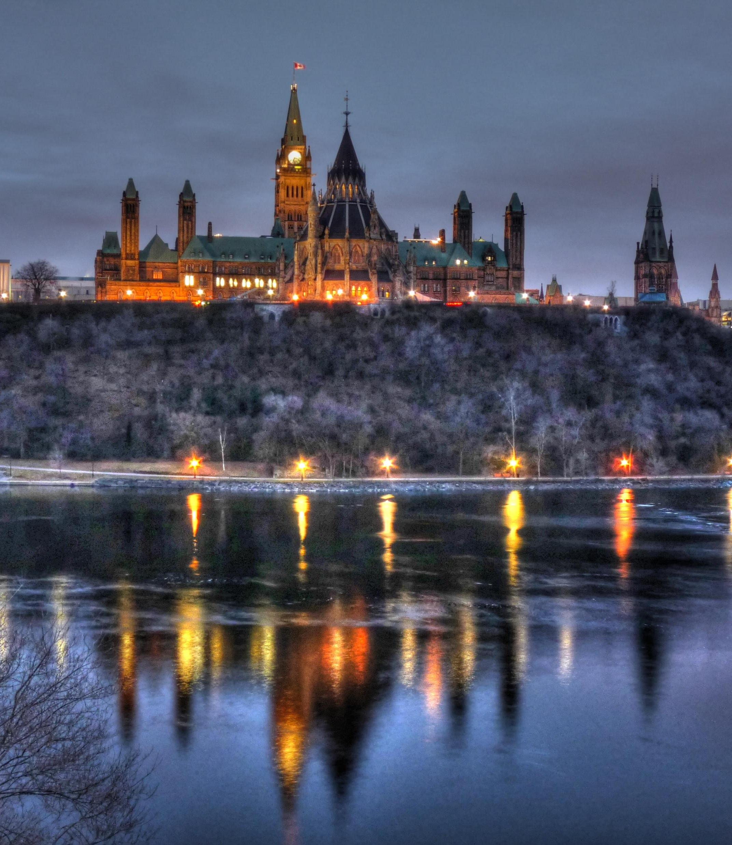
Ottawa Charter
The first International Conference on Health Promotion, meeting in Ottawa 21st November 1986, hereby presents this CHARTER for action to achieve “Health for All by the year 2000 and beyond.”
A charter was written to outline the “aims, processes and outcomes desired by the World Health Assembly and to motivate nations to promote health.” (Lockhart, 2010)
Ottawa Charter – WHO link
This Photo by Unknown Author is licensed under CC BY-SA

Slide 84
What are the prerequisites for health? (The fundamental conditions/resources required for positive health)
peace
shelter
education
food
income
a stable eco-system
sustainable resources
social justice and equity
THIS IS WHAT WE ARE AIMING FOR THROUGH HEALTH PROMOTION!

Slide 85
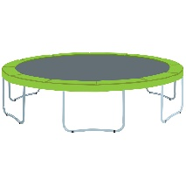
The charter outlines 3 overarching strategies for effective Health Promotion:
Enable – To make possible by empowering or helping, to give strength to or aid with the ability complete a task
– I can enable you to dunk a basketball by giving you a trampoline
Mediate – Act between people to help solve problems or disputes, intervene as negotiator or objectivity to bring about a resolution or agreement
– I can mediate and argument for you and your BFF
Advocate- to recommend or plead for a cause. To push an agenda or try to influence an outcome
– I can speak up for someone or something that doesn’t have a voice (figuratively or literally)

Slide 86

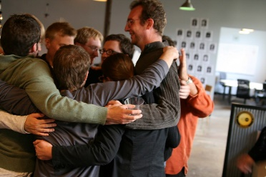

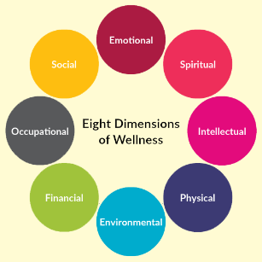

These 3 strategies work in the 5 action areas of the Ottawa Charter
The Charter identified five areas that can be used to help guide countries with their implementation of health promotion.
1) Build healthy public policy
2) Create supportive environments
3) Strengthen community action
4) Reorient health services
5) Develop personal skills

Slide 87
Build Healthy Public Policy
What is a policy? a course or principle of action adopted or proposed by an organization or individual
By having a healthy public policy, we are able to legislate healthy behaviours, and ban unhealthy ones.
This policy will include:
Legislation (laws)
Taxation
Organisational change
Examples?
Tobacco
Alcohol
Physical Activity in Schools

Slide 88
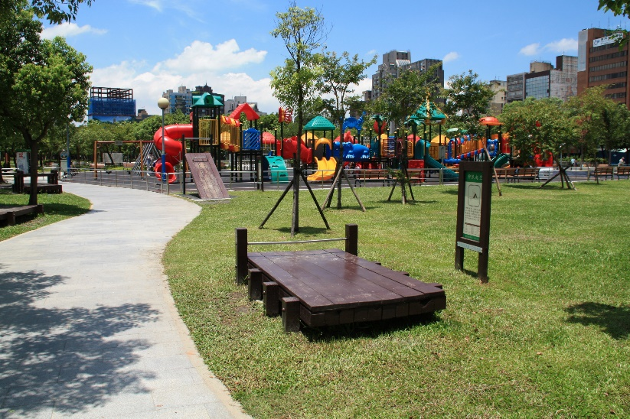
Create Supportive Environments
People will be strongly influenced by their environment, so we must take a socioecological approach to health.
To promote health, people need to take care of each other, the community and the surrounding natural environment.
The living and working conditions that people are exposed to need to be safe, stimulating, satisfying and enjoyable in order to promote health and wellbeing.
Examples?
WorkSafe (pg 29)
School
Mt Henry Bridge
This Photo by Unknown Author is licensed under CC BY-SA

Slide 89

Strengthen Community Action
Community participation in change is needed in order for the community to be empowered.
An empowered community:
Takes control of their own health
Sets priorities
Creates action plans
Evaluates outcomes
There is a strong link between community empowerment and communities adopting heath initiatives.
Eg. Fundraising for shade at the local park
E.g. Community Fun runs!
This Photo by Unknown Author is licensed under CC BY-SA

Slide 90

Reorient Health Services
Health care facilities need to change their attitudes and values in order to have a focus on the patient as a whole person.
To achieve this, several services can be placed in the one area, or more services can be placed where they are needed.
Health care providers need to respect the cultural needs of the individual and community, in order to be able to help support them.
Example:
Headspace
Kids Help Line
Fremantle/Cockburn health centres
This Photo by Unknown Author is licensed under CC BY-SA

Slide 91
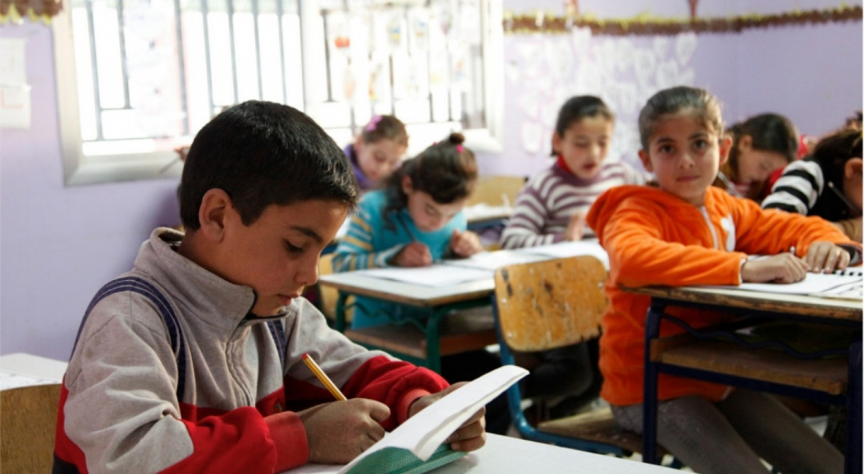
Develop Personal Skills
“People need to be committed to develop skills necessary to lead fulfilling, independent lives where they can make healthy choices” (Lockhart, 2010).
A key tool to helping people with developing these skills is education.
Education can take place at:
School
Home
Work
In Community Settings
This Photo by Unknown Author is licensed under CC BY-SA

Slide 92
Class Activity: Online Posters!
Create an A3 poster online which outlines the action areas.
Must include
Description of each action area
3 unique examples for each action area
A creative look/imagery
Use Canva.com to create the poster.
Send me your poster via direct message when it is done!
http://www.who.int/healthpromotion/conferences/previous/ottawa/en/index1.html

Slide 93
Health Inquiries
SYLLABUS:
Planning a health inquiry
identification and description of a health issue
development of focus questions to research a health issue
Use of a range of information to explore a health issue
identification and use of a range of reliable information sources
identification and application of criteria for selecting information sources
Interpretation of information
summary of information
identification of trends and patterns in data
development of argument
development of general conclusions
Presentation of findings in appropriate format to suit audience

Slide 94
What is a Health Inquiry?
Research
A health inquiry has a purpose of exploring health issues, by gathering data and information, in order to develop conclusions and make recommendations to improve the health and wellbeing of a population or community.
Structure
A health inquiry needs to follow a specific structure in order to be successful.
By following this structure in the correct sequence, we are able to ensure that all efforts are reliable, and all findings are credible.

Slide 95
Examples of “real” inquiries (Royal Inquiries)
Child Sex Abuse - https://www.childabuseroyalcommission.gov.au/final-report
Banking - https://www.abc.net.au/news/2019-02-04/banking-royal-commission-report-at-a-glance/10777188
Aged Care - https://agedcare.royalcommission.gov.au/Pages/default.aspx

Slide 96
7 steps to conduct a health inquiry
Step 1-Identifying a health issue.
Step 2-Develop focus questions.
Step 3-Find appropriate resources.
Step 4-Gather appropriate information.
Step 5-Summarise information
Step 6-Final conclusions and recommendations
Step 7-Presentation

Slide 97

Step 1:
When undertaking a health inquiry it is important to research the health issue.
It is recommended to work out what interests the researcher, and to follow that path when planning the inquiry.
It is crucial that the researcher is specific with their topic-choose one, specific topic to focus on and explore it in great depth.
Once the researcher has decided on the topic, they need to describe the health issue in detail. During this description, it is important to create a “problem statement”.
This Photo by Unknown Author is licensed under CC BY-SA-NC

Slide 98
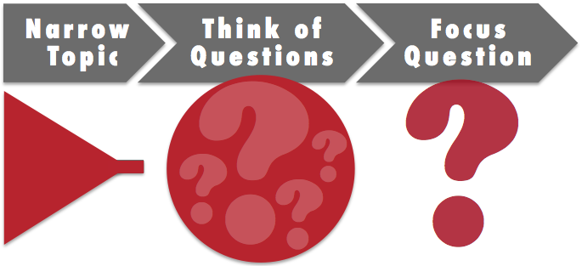
Step 2:
Once the researcher has completed their description, they need to create focus questions.
The focus questions are crucial as they are used to explore the issue and allow for recommendations or conclusions to be drawn.
The focus questions need to:
Be open-ended
Be specific and clear
Ask only one thing
Be able to be answered through information and/or data.
“How can cancer be prevented?” v “Which primary prevention strategies are best used to prevent cervical cancer in Australia?”
This Photo by Unknown Author is licensed under CC BY

Slide 99

Step 3:
Once the focus questions have been finalised, it is important to locate reliable information sources.
The evidence needs to be from a variety of sources, in order to avoid skewed data.
Once the researcher has found sources that they believe to be credible, it is important to go though a checklist.
Pg 113 Textbook
This Photo by Unknown Author is licensed under CC BY-SA-NC

Slide 100
Step 3 continued:
Steps to locating reliable and relevant sources:
Locating sources. It is important for us to find a range of sources. These sources can be found on the internet, in books, in the media, and through interpersonal methods.
Reliability. When analysing whether a source is reliable or not, it is important to assess:
Recency, reputation, qualifications, location, bias, values, personal gain, consistency, confirmation, witness/research and means of obtaining the information.
Multiple sources. By finding information from more than one source the research is more likely to be accurate. As well as this, try to locate a variety of resources (rather than just one website).
This Photo by Unknown Author is licensed under CC BY-SA-NC

Slide 101

Step 4:
Once the researcher has confirmed that the sources are credible and reliable, they need to gather information to answer the focus questions.
To do so, the researcher should create notes for each question, from multiple sources.
These notes need to be in the researchers own words, and can be used to cross-reference information from different sources.

Slide 102
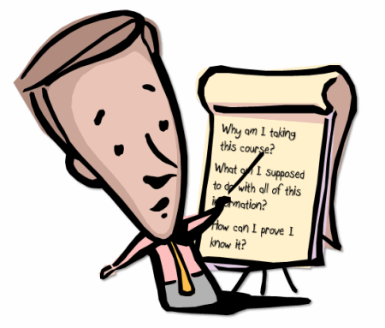
Step 5:
Once the information has been collected for each focus question, it is time for the researcher to summarise the information and answer the questions.
When summarising, it is important to identify the key points/findings in the information.
The summary should “sum-up” the information that has been found.
When finishing the summary, it is important for the researcher to re-read the information and ensure that it reflects the original finding of the sources.
This Photo by Unknown Author is licensed under CC BY

Slide 103

Step 6:
Once the focus questions have been answered, the researcher needs to develop their own argument and conclusions on the topic.
Page 117 textbook
Once the argument has been developed, a clear conclusion can be drawn.
All recommendations to improve health within this topic should be found within the conclusion. E.g. pg 117 textbook
When writing these recommendations, the researcher can support their statements by sourcing evidence that comes to the same/similar conclusions.
This Photo by Unknown Author is licensed under CC BY-SA-NC

Slide 104

Step 7:
Finally, it is important to present the findings of the inquiry in a way that is suitable to the audience.
Findings can be presented through:
Oral presentations
Poster presentations
Reports
Website
Documentary
The presenting it is important to avoid using jargon and technical language, unless the audience is familiar with it.

Slide 105

Let’s look a bit closer at data interpretation:
There are times where we can find trends or relationships in data.
Positive trend: If an increase in one set of data coincides with an increase in the values of another set of data, it shows a positive relationship. A positive trend means both sets of data are closely related, however it does not determine cause.
Negative trend: If the values of one set of data increase, and the values of the other set decrease, it shows a negative trend.
No Trend
When describing a trend use the formula shown on pg 116 of the textbook

Slide 106
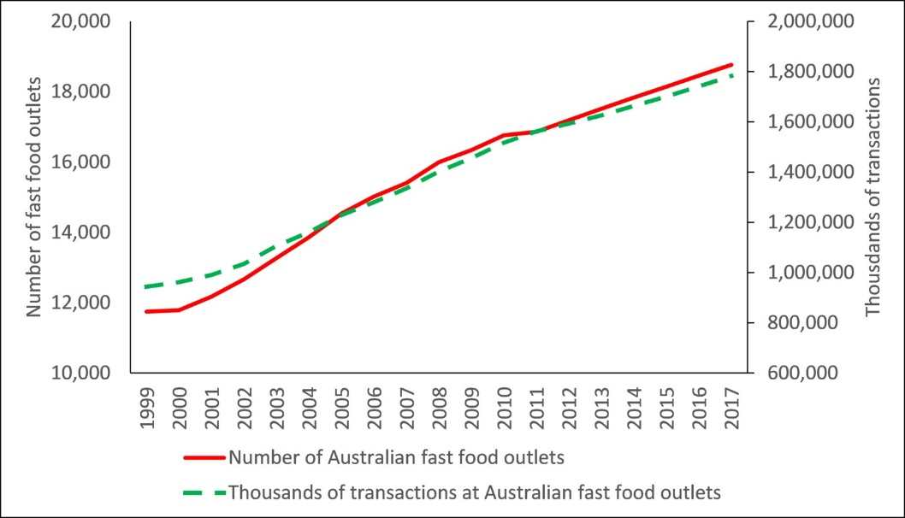
Describing trends:
You can follow the trend formula:
“As A increases/decreases, B increases/decreases so the data follows a positive/negative trend.”
A and B are replaced with the data being described (often on the two axis of the table/graph)
In Australia, as the number of fast food outlets increases, the number of thousands of transactions increases, so the data follows a positive trend.

Slide 107
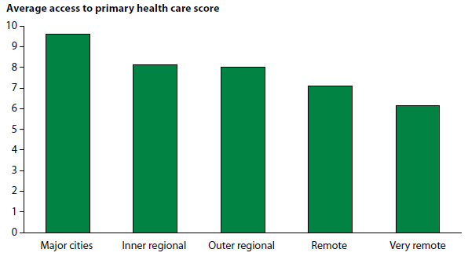
Describing trends:
Describe the trend in the graph above:
As the distance from a Major City increases, the average access to a primary health care source decreases, so the date follows a negative trend.

Slide 108
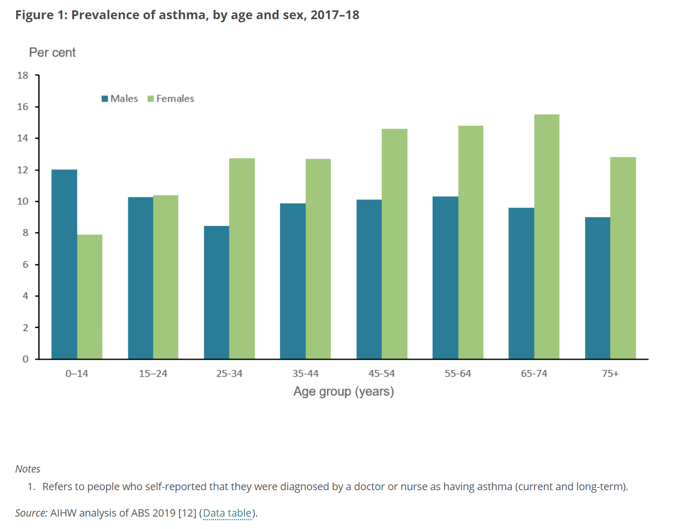
Describing trends:
Describe any trends in the graph above

Slide 109
Review Question
Find a table on AIHW on a topic that interests you.
Interpret and describe data trends and key observations you can identify.
Explain, using your knowledge of this area, what possible reasons/factors could be influencing the data.
Share your findings with the class :)

Slide 110
Sources
Lockhart, E. (2010). Health Studies Stage 2A-b. Madeley: Print Publishing.
Image from:
http://yemenembassy.ca/eng/
Image from:
http://www.grlc.vic.gov.au/book-clubs
Image from:
http://www.aihw.gov.au/australias-health/2014/indigenous-health/
Image from:
http://theconversation.com/fat-nation-why-so-many-australians-are-obese-and-how-to-fix-it-23783

Slide 111
Social & Cultural Norms
SYLLABUS:
Social and cultural Norms
Definition of social and cultural norms
Influence of the media on social norms and health behaviour

Slide 112
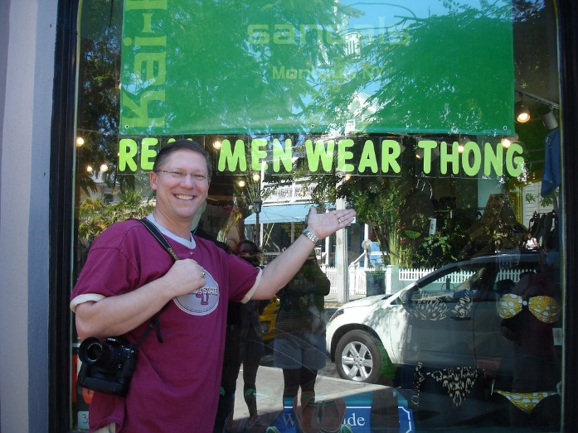
What is a social norm?
“Peoples belief about the attitudes and behaviours that are normal, acceptable or expected in a particular social context.”
Behaviour that is a regular part of society
Is based on a socially shared belief of how one ought to behave.
Helps enforce behaviour (social consequence if the expected behaviour is not adhered to)
“the unwritten rules” by which a social group behaves.
https://www.youtube.com/watch?v=kGrVhM_Gi8k
- 10 mins Symbols, Values & Norms: Crash Course Sociology #10
This Photo by Unknown Author is licensed under CC BY

Slide 113
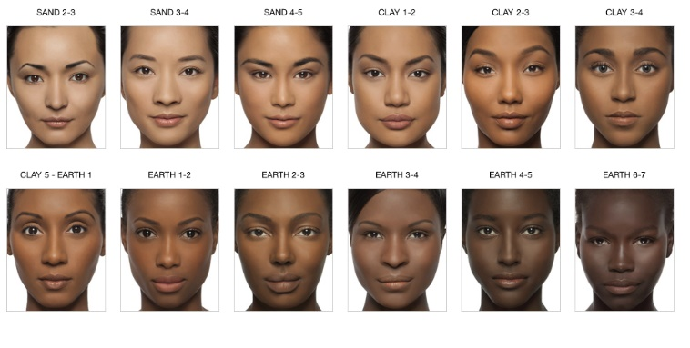
What are cultural norms?
“behaviour patterns of specific groups due to their cultural upbringing.”
Ie. Geographical location
Country of origin
Ethnic affiliation
Religious Practices
Pale skin in Philippines seen as desirable/attractive
Tanned skin in Australia seen as desirable/attractive
https://www.youtube.com/watch?v=BT0kzF4A-WQ
This Photo by Unknown Author is licensed under CC BY-NC-ND

Slide 114
How are these norms constructed?
SOCIAL:
Like-minded people congregate together!
(similar views, preferences and opinions draw people together)
Newcomers must adhere to the “norm” or risk being viewed as different. 2 min video on conformity
Example? Primary School Classroom Parents
https://www.simplypsychology.org/social-roles.html

Slide 115
How are these norms constructed?
CULTURAL:
Very similar to social norms
Cultural norms generally have less CHOICE of the individual.
Often determined by family expectation.
Examples: family country of origin, traditions, where they live, language spoken, cultural customs etc.
https://www.sbs.com.au/ondemand/video/1469778499693/dateline-forced-to-be-fat - Dateline 25 mins

Slide 116
Class activities
In pairs, brainstorm 2 unhealthy and 2 healthy behaviours that you would consider to be “norms” in Perth, WA.
Jump online and find a cultural norm that exists elsewhere in the world that you feel is unhealthy. (or you feel is having a negative impact on the health status of that population) Share with the class ☺

Slide 117

Transmission of norms:
FOUR WAYS:
Explicitly-written or declared
Eg. Legislation stating that children must be immunized before attending public school
Implied-unwritten/undeclared but suggested
Eg. Body language like a disapproving glare if someone mentions that their child is not immunized
Observed-required behaviour is obvious because others are adhering to the given behaviour.
Eg. All parents coming in to school on immunisation day
Expectation-families, employers, schools/social groups place “expectations” on people to conform to “fit in”
This Photo by Unknown Author is licensed under CC BY-NC-ND

Slide 118
Social Cognitive Theory
Why do we use it?
1. It helps explain the links between the social/cultural environment
and behaviour
2. It shows that norms can influence the expectations an individual places on themselves and others around them
https://www.youtube.com/watch?v=UbruJh0MODI
10 mins Bandura SLT

Slide 119
Social Cognitive Theory
Personal factors
(Thoughts, beliefs, cognitive competencies, skills and strategies)
Environmental determinants
(Social setting, location, cultures, peers, family)
Behaviour
(health behaviours)
Influence of a persons beliefs and intellect on others and the way knowledge and belief are developed and modified by social influences
Influences of a persons thoughts, beliefs or skills on their actions.
Persons behaviour influencing their environment and in turn their behaviour being modified by that environment.

Slide 120
Influence of the media on norms
Norms are promoted by behaviour of the “MAINSTREAM”
They are also promoted by the MEDIA.
Ie. Television/movies shows display fashions, behaviours and lifestyles that reflect different social/cultural norms.
Ie. Celebrity role model behaviour promote norms and influence behaviour expectations.
Ie. Advertising often gives the message that you are not “normal” without their product/service or that we require it to be happy and healthy.

Slide 121
Changing norms
If we can change beliefs/attitudes/values then we can change norms
People follow norms for two reasons:
Because of the expectations to follow it.
Because of the expectations of consequences if they DON’T follow it.
(ie. What they believe will happen to them if they aren’t taking part in the mainstream behaviour)

Slide 122

Strategies to change norms
TEXTBOOK page 80
1. Discuss Consequences
(e.g. conversation about spread of disease without vaccination)
2. Inform
(eg. inform community about the importance of herd immunity)
3. Highlight inconsistencies in beliefs.
(eg. Highlight inconsistency that they may want to protect those whose immune system is compromised, but unwilling to get vaccinations)
4. Present a different core belief to replace the existing one
(eg. Vaccinations are not linked to autism in any way)
5. Change commonly shared beliefs
(eg.change the belief that only some people need to get vaccinated, to the belief that all people should be vaccinated. )
This Photo by Unknown Author is licensed under CC BY

Slide 123
Revision Questions
Question 1. Apply the Social Cognitive Theory to a teenage party. Consider dating, alcohol, fashion, supervision, music and food choices.
Question 2. Prepare a half page argument/presentation for a debate for the following statement:
“ In Australia social norms promote unhealthy behaviours”
-choose affirmative or negative.
-prepare an introduction, a few main points and conclusion.

Slide 124
Sources:
Lockhart, E. (2015). Health Studies Stage 2A-b. Madeley: Print Publishing.

